Slide 1
In The Wake of Suicide
A discussion of the facts, misconceptions and grief following suicide.
Deborah R. Major, Ph.D, LCSW
LOSS Program Catholic Charities of the Archdiocese of Chicago
The Upper Room
April 9, 2024
Notes:
Who is present? Survivors? acknowledge topic sensitivity

Slide 2
The Facts
49,449 suicides occurred in the U.S. in 2022 (cdc.gov).
Men are four times more likely to die by suicide (Men represent 79% (39,255)/Women 21%(10,194).
The number who attempt suicide is higher.
Second leading cause for those between 10 to 14.
Third leading cause of death for those aged 15 to 24.
Second leading cause of death for those between the ages of 25-34.
Fifth leading cause of death for those 35 to 44.

Slide 3
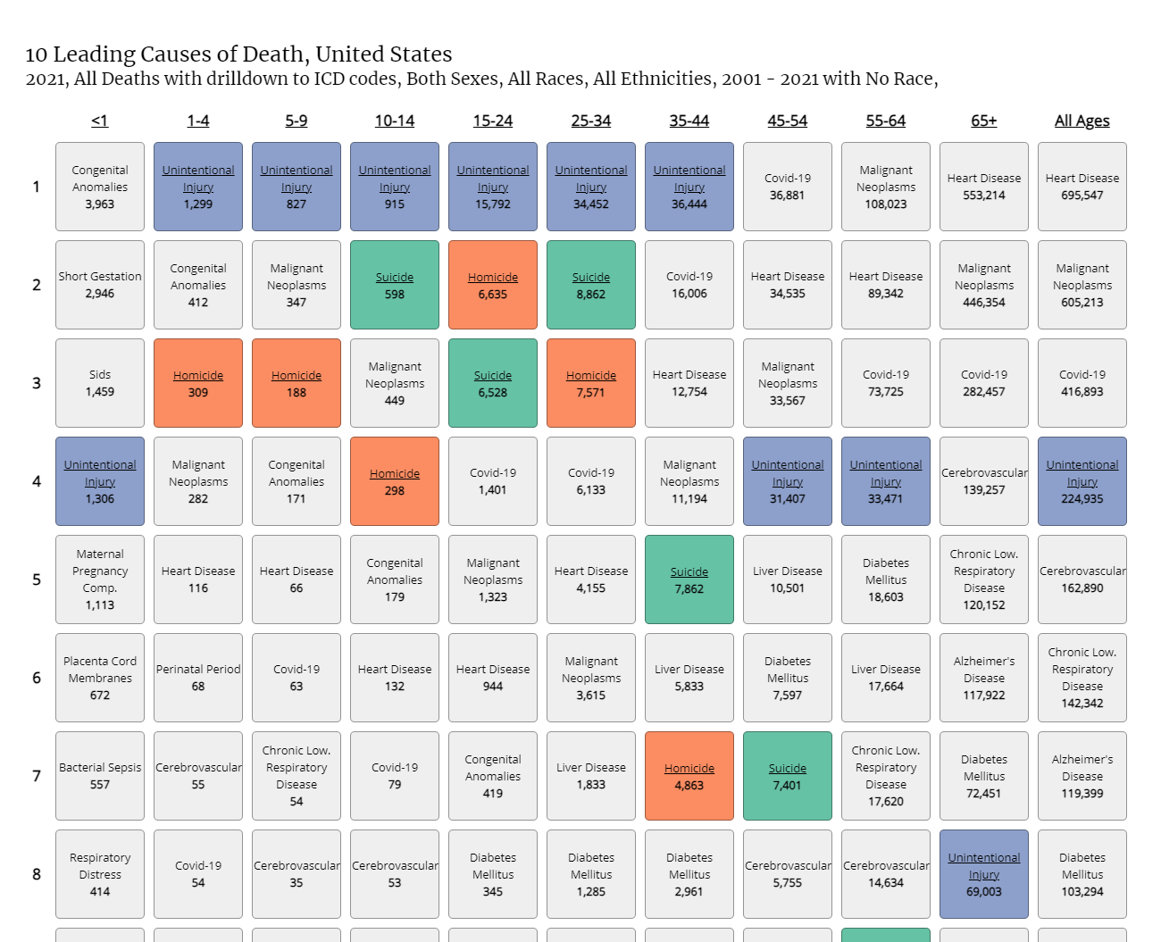

Slide 4
Methods
Firearms are the most common method used (54.6%)
Suffocation (25.8%)
Poisoning (11.6%)
Other methods (8%) (CDC.gov Vital Statistics)

Slide 5
Racial Disparities
Groups with the highest rates in 2021 were American Indian and Alaska Native people followed by non-Hispanic Whites.
American Indian/Alaska Native 28.1%
Non-Hispanic White 17.4%
Native Hawaiian/Pacific Islander 12.6%
Non-Hispanic Multiracial 9.7%
Non-Hispanic Black 8.7%
Hispanic 7.9%
Asian 6.8%

Slide 6
Who is at risk?
History of previous suicide attempts.
Family history of suicide.
History of depression or other mental illness.
Alcohol or drug abuse.
Impulsive or aggressive tendencies.
Stressful life event or loss (physical illness).
Easy access to lethal methods.
Exposure to the suicidal behavior of others.
Unwillingness to seek help.
Incarceration
Isolation, sense of being cut off from others (cdc.gov).

Slide 7
Protective Factors
Family and community support (connectedness).
Skills in problem solving, conflict resolution, and non-violent ways of resolving disputes.
Cultural and religious beliefs that support instincts for self-care (support for seeking help).
Strong sense of cultural identity.
Effective clinical care for mental, physical, and substance abuse disorders.
Easy access to a variety of interventions and support for help seeking (cdc.gov).
Reduced access to lethal means of suicide.

Slide 8
Misconceptions about Suicide
That the person was selfish.
That the person was a coward.
That a singular cause can be identified.
That only “certain kinds” of people die by suicide.
That only “crazy” people complete suicide.
That suicide is a sin and the soul goes to hell.
That suicide is inherited and runs in families.
Notes:
The act is very complex. The media tends to simplify and boil it down to a particular cause. People diagnosed with depression are at greater risk, as are those with substance abuse disorders and mental illness. However, not everyone who ends his life has a diagnosis. There is greater risk in families where a suicide has occurred, but it isn’t an inherited risk.

Slide 9
More Misconceptions
That suicide loss always results in complicated grief.
“Won’t my child’s life be ruined forever?”
That grief after suicide proceeds in predictable, orderly stages (Kubler-Ross).
That we will be able to find one definitive explanation.
That tears of grief are a sign of weakness.
That grieving openly means one’s faith is weak.
These misconceptions reinforce stigma and make the grief process more painful for survivors of suicide loss.

Slide 10
Why People Die by Suicide (Joiner, 2005)
Psychological autopsies used hospital records, case notes, family interviews.
Joiner’s findings revealed that suicidal individuals:
Believed they were a burden to others.
Tended to withdraw, leading to feeling and being disconnected.
Tended to refuse help that was offered.

Slide 11
The Suicidal Mind (Shneidman, 1996)
Researched lives of individuals who died by suicide.
Researched individuals who narrowly survived life-threatening suicide attempts.
His research identified 10 common features in individuals who were suicidal.

Slide 12
Common Features
Common emotion: hopelessness and helplessness.
Common stimulus: unbearable psychological pain.
Common stressor: frustrated psychological needs.
Common goal: cessation of consciousness.
Common perceptual state is constriction.
Common action is escape.
Common purpose: to seek a solution (Shneidman, 1996)

Slide 13
What makes suicide loss different?
Usually (but not always) sudden and unexpected.
Often violent death.
No opportunity for psychological preparedness.
Increased sense of unreality.
Increased risk of distress.
Greater risk for complicated bereavement.
Greater risk for depression, anxiety, PTSD (especially for those who find the body of the deceased).
Notes:
Suicide is generally experienced as a traumatic death. Survivors come to us appearing shell-shocked; not just grieving, but also stripped of an understanding of the world and their place in it. Nothing makes sense to them

Slide 14
Who is a suicide survivor?
Anyone who experiences a high level of self-perceived psychological, social or physical distress for a considerable period of time after exposure to the suicide of another individual (Jordan & McIntosh, 2011).
High rate of exposure of suicide in the U.S.
CDC reported 49,449 suicides in 2022 (cdc.gov).
The LOSS Program offers 13 monthly groups for survivors
6 in-person monthly groups
7 online monthly groups
Individual counseling for Illinois residents

Slide 15
Grief after Suicide
High degree of shame and stigma.
Feelings of rejection and abandonment.
Pressure to conceal the cause of death.
Blaming, especially self-blame.
“Who is responsible” for this death?
Increased self-destructiveness.
Some survivors experience suicidal ideation.
Notes:
The shame and stigma can send mourners underground. For example the Polish family who decided to hide the cause of their son’s death. The shame may twist the family’s preferred funeral rites, forcing them to keep it quiet to the point where families do not receive the support they need to facilitate healthy mourning.
This way of dying is so difficult to accept that it leads many to look for a scapegoat (blaming). Family members may blame each other (family example). They may blame mental health professionals (example). Often survivors blame themselves. The self-blame can become quite self-destructive.

Slide 16
Common Reactions
Guilt: “If only I had … I should have, could have …”
Search for an explanation (“Why did he do this?”)
Shock and disbelief
Anger
Family system effects
Social isolation, social support issues
Obsession with the phenomenon of suicide
May experience a sense of relief (if there had been a longstanding, disruptive history of severe mental illness).
Notes:
How do individuals and families respond to the suicide of a loved one? We see a wide range of emotional, psychological, behavioral, and social fallout. Many parents are initially immobilized. They can’t get out of bed; can’t think clearly; can’t mobilize enough energy to do things that they would have done without even thinking about it. Some people find that they cannot function at work or home. Parents find themselves unable to do what they could do for their children prior to the death. Parents may be much more irritable with a child; simply did not enjoy her and did not enjoy parenting whereas before the child had been the center of her life.
Many people experience themselves on an emotional roller coaster, hit by waves of overwhelming and conflicting feelings.

Slide 17
Normal Grief Reactions are exacerbated with suicide
Sadness
Yearning
Guilt
Anger
Anxiety
Loneliness
Fatigue
Helplessness
Shock
Numbness
Relief

Slide 18
Thought Patterns in Grief
Disbelief
Confusion
Preoccupation with the death and the person
Sense of presence of the deceased
Signs of communication from the deceased (Worden, 2002)

Slide 19
Common Behaviors
Appetite disturbance
Sleep disturbance
Crying, sighing
Absentmindedness
Social withdrawal
Relentless over-activity
Visiting places as reminders
Avoiding reminders of the deceased
Carrying or treasuring objects as reminders (Worden, 2002)

Slide 20
Complicated Grief
Grief “gone wrong.”
People “get stuck” in a chronic state of mourning.
Unable or unwilling to create new roles, new relationships, unwilling to reinvest in life.
Marked impairment in functioning over an extended period.

Slide 21
Complicated Grief Symptoms
Intrusive thoughts related to the deceased.
Intense pangs of separation distress.
Confusion about one’s role in life.
Diminished sense of self.
Inability to trust others since the loss.
Bitterness or anger related to the loss.
Difficulty reengaging in life.
Feeling that life is empty or meaningless.
Impairment in social, occupational or other areas of functioning.

Slide 22
Reinvesting in Life
Psychological reinvestment in life begins with:
De-identification with the suicidal piece of the loved one’s life.
Discovery of new sources of meaning and pleasure.
Finding adaptive meaning in the death.
Recovering interest in creating a fulfilling life.
Opening to the possibility of post-traumatic growth (deeper appreciation of life, of one’s own life, the life of the deceased).

Slide 23
LOSS History
Three couples (1979) grieving the loss of their teen children meet at Compassionate Friends.
They felt their grief from suicide loss was different by comparison with other parents in the group.
At their request Catholic Charities began a special support group for these couples.
They initially met in the home of one of the couples.
Over time more groups were added throughout the Chicagoland area.
During the pandemic we transitioned to virtual services.
Post-pandemic services are hybrid: some in-person and some virtual allowing us to serve a broader base.

Slide 24
LOSS Program Services
Monthly Grief Support Groups.
Specific groups for spouses, parents and young adults.
Group leadership includes two facilitators who are survivors and one mental health professional.
Eight-week groups for the newly bereaved.
Individual and family counseling.
The Obelisk monthly newsletter.

Slide 25
A Philosophy of Companioning
Being present to the griever’s pain; not about taking it away.
Bearing witness to the struggles of others; not judging or directing them.
Walking alongside, not leading.
Respecting confusion without imposing order.
Honoring the spirit; not focusing on the intellect.
Listening to the heart; not analyzing with the head (Wolfelt, 2006).

Slide 26
References
Centers for Disease Control. www.cdc.gov/violenceprevention/suicide
Calhoun, L.G., & Tedeschi, R.G. (2006). Handbook of posttraumatic growth: Research and practice (pp. 3-23). Mahway, NJ: Lawrence Erlbaum Associates.
Joiner, T. (2005). Why people die by suicide. Cambridge, MA: Harvard University Press.
Jordan, J. R., & McIntosh, J. L. (Eds.). (2011). Grief after suicide: Understanding the consequences and caring for the survivors. New York: Routledge.
Shneidman, E. S. (1996). The suicidal mind. New York: Oxford University Press.
Wolfelt, A. D. (2006). Companioning the bereaved: A soulful guide for caregivers. Fort Collins, CO: Companion Press.
Worden, J. W. (2002). Grief counseling and grief therapy: A handbook for the mental health practitioner (3rd ed.). New York: Springer Publishing Company.

